Slide 1
Author Identity Recognition
Phase II Experiment Results

Slide 2
Experiments Performed
“The Road Not Taken”(94 unique words)
“The quick brown fox…” (8 unique words)
“jumps” (1 unique word)
Visual Studio & Jupyter Notebook

Slide 3
Comparing Graphs
Left-right, top-bottom:
“The Road Not Taken”
“The quick brown fox…”
“jumps” (C++)
“jumps” (Python)

Slide 4
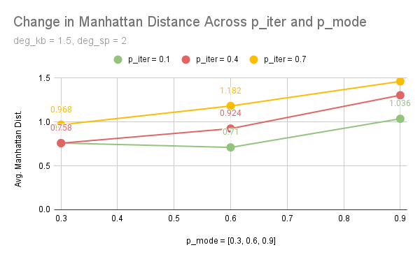
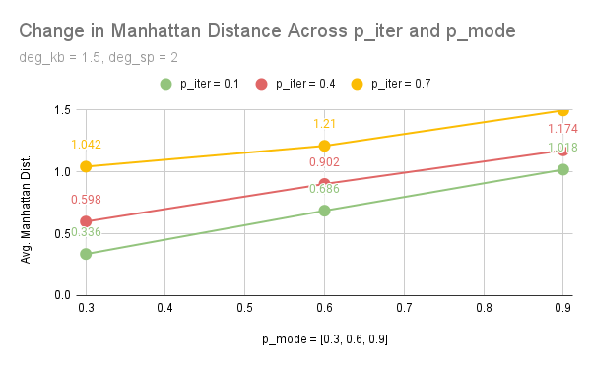
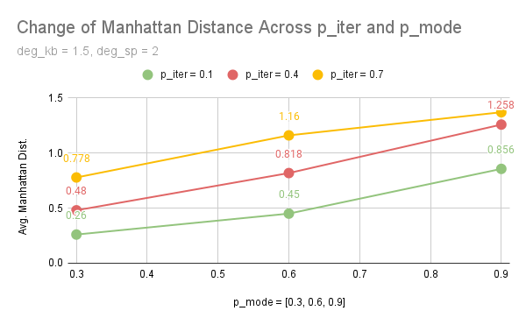
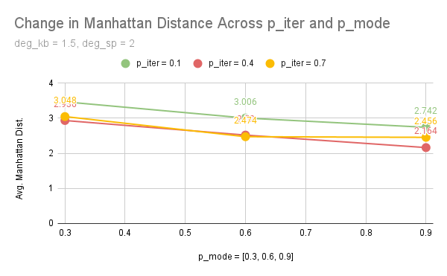

Slide 5
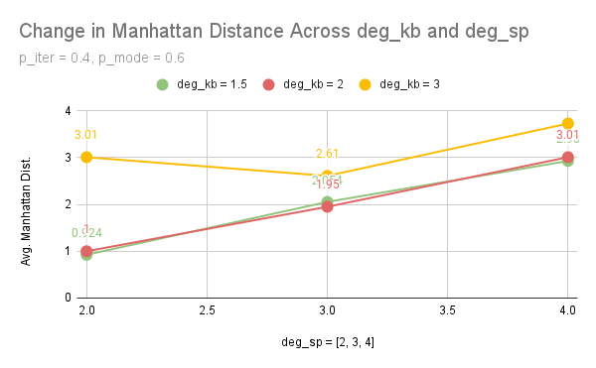
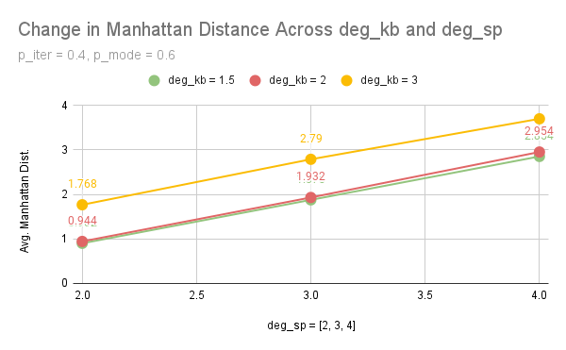
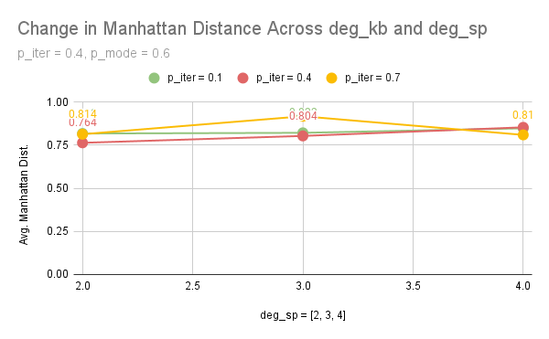
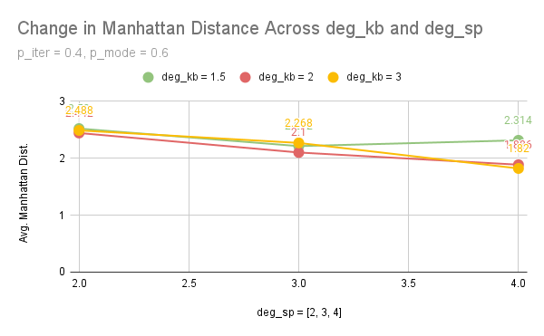

Slide 6
Findings/Questions
Why does Jupyter Notebook give opposite results?
p_iter and p_mode seem to affect the results more than deg_kb and deg_sp only when using “jumps”

